Slide 1
Artificial Intelligence
CS-451
Instructor: Dr Syed Musharaf Ali

Slide 2

Problem Solving

Slide 3
Problem Solving
The process of working through details of a problem to reach a solution or a goal.

Slide 4
Problem Solving Agent
Problem-solving agent
Decides what to do by finding sequences of actions that lead to desirable states (goal) as well as maximizes the performance measure

Slide 5
Problem Solving Agent
Goal Formulation:
Goal is normally considered to be set of states in which the Goal is satisfied
Problem Formulation: is the process of deciding what actions and states to consider, given a goal
For problem solving we assume environment should be observable, discrete, and deterministic.

Slide 6
Problem Solving Agent
Search is the process of looking for a sequence of actions that reaches the goal
A search algorithm takes a problem as input and returns a solution in the form of an action sequence (planing phase). Once a solution is found, the actions it recommends can be carried out. This is called the execution phase.

Slide 7
Well-defined problems and solutions
Solution to a problem
A solution to a problem is an action sequence that leads from the initial state to a goal state.
Solution quality is measured by the path cost function,
An optimal solution has the lowest path cost among all solutions.

Slide 8
Searching for Solutions
State Space:
The set of states forms a graph where two states are connected if there is an operation that can be performed to transform the first state into the second.
State space search is a process in which successive states of an instance are considered, with the goal of finding a goal state with a desired property.

Slide 9
Well-defined problems and solutions
A problem can be defined formally by five components:
S: The initial state S that the agent starts in.
ACTIONS(s): A description of the possible actions available to the agent. Given a particular state s, ACTIONS(s) returns the set of actions that can be executed in s
RESULT(s, a) : A description of what each action does; the formal name for this is the transition model, specified by a function RESULT(s, a) that returns the state that results from doing action a in state s
Goal test: The goal test, which determines whether a given state is a goal state. Sometimes there is an explicit set of possible goal states, and the test simply checks whether the given state is one of them.
Path cost: A path cost function that assigns a numeric cost to each path.
The cost of taking action a in state s to reach state s’ is
denoted by c(s, a, s’ ).

Slide 10
Searching for Solutions
Search Tree:
It is helpful to think search process as building up a search tree that is superimposed over the state space (graph)
Root of the search tree is a search node corresponding to the initial state.
The Leaf nodes of the tree correspond to states that do not have successors in the tree.

Slide 11
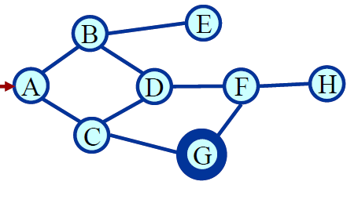
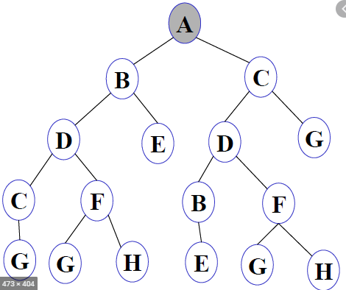
Search Tree:

Slide 12
Search Strategies
Criteria for evaluation of a search strategy:
Completeness: Strategy must gaurantee to find a solution, if there exist one
Time complexity: How much time it takes to find a solution
Space complexity: How much memory it needs
Optimality: does the strategy find the highest-quality solution when there are different solutions

Slide 13
Search Strategies
Uninformed Search / Blind Search:
They have no information about the number of steps or the path cost from the current state to the goal state.
All they can do is to distinguish a goal state from a non-goal state
Informed Search / Heuristic Search:
Search strategy that ranks alternatives in search algorithm at each branching step based on available information to decide which branch to follow to achieve goal.
Notes:
Heuristic: enabling a person or entity to discover or learn something for themselves.

Slide 14

Breadth-First Search
Root node is expanded first
Then all the nodes generated by root node are expanded next and then their successors and so on
If there is a solution then BFS is guaranteed to find it.
If there are several solutions, BFS always find the shallowest goal state first
Breadth-first search trees after 0,1,2, and 3 node expansion
Notes:
Heuristic: enabling a person or entity to discover or learn something for themselves.

Slide 15
Graph Traversals
BFS (Breadth First Search)
Breadth First Search (BFS) algorithm traverses a graph/tree in a breadth ward motion and uses a queue to remember to get the next vertex to start a search, when a dead end occurs in any iteration.
Rule 1 − Visit the adjacent unvisited vertexes. Mark it as visited. Display it. Insert it in a queue.
Rule 2 − If no adjacent vertex is found, remove the first vertex from the queue.
Rule 3 − Repeat Rule 1 and Rule 2 until the queue is empty.

Slide 16
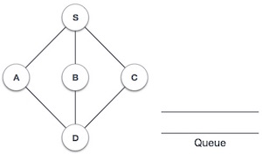
Graph Traversals
BFS (Breadth First Search)
https://www.tutorialspoint.com/data_structures_algorithms/breadth_first_traversal.htm

Slide 17
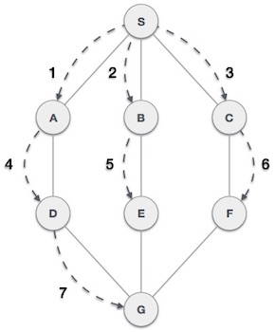
Graph Traversals
BFS (Breadth First Search)
https://www.tutorialspoint.com/data_structures_algorithms/breadth_first_traversal.htm

Slide 18
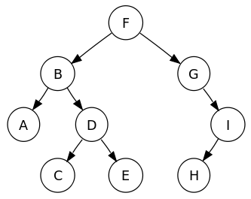
Tree Traversals
BFS (Breadth First Search): example

Slide 19
Breadth-First Search
Breadth First Search
Complete | Yes
Time Complexity | ?
Space Complexity | ?
Optimality | Yes
Notes:
Heuristic: enabling a person or entity to discover or learn something for themselves.

Slide 20
Breadth-First Search
Suppose branching factor is b
The root of the search tree generates b nodes at the first level, each of which generates b more nodes, for a total of b² at the second level.
Each of these generates b more nodes, yielding b³ nodes at the third level, and so on.
Now suppose that the solution for this problem has a path length of d.
Then the maximum number of nodes expanded before finding a solution is
Total number of nodes at level d = 1 + b + b² + b³ + • • • + b ͩͩ
Notes:
Heuristic: enabling a person or entity to discover or learn something for themselves.

Slide 21
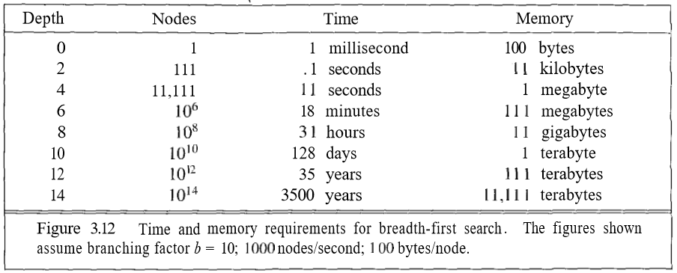
Breadth-First Search
Complexity factor = O(b ͩͩ)
If b = 10, process 1000 nodes/second, 100 bytes/node => Computationally expensive
³
Notes:
Heuristic: enabling a person or entity to discover or learn something for themselves.

Slide 22
Breadth-First Search
Complexity factor = O(bͩͩ)
Exponential complexity search problems suitable for small instance problems
Breadth First Search
Complete | Yes
Time Complexity | Exponential
Space Complexity | Exponential
Optimality | Yes
Notes:
Heuristic: enabling a person or entity to discover or learn something for themselves.

Slide 23
Depth-First Search(DFS)
Depth-first search (DFS) always expands one of the nodes at the deepest level of the tree
If branching factor is b and depth level is d, then DFS opens (1+bd) nodes
Notes:
Heuristic: enabling a person or entity to discover or learn something for themselves.

Slide 24
Graph Traversals
DFS (Depth First Search)
Depth First Search (DFS) algorithm traverses a graph in a depthward motion and uses a stack to remember to get the next vertex to start a search, when a dead end occurs in any iteration.
Rule 1 − Visit the adjacent unvisited vertex. Mark it as visited. Display it. Push it in a stack.
Rule 2 − If no adjacent vertex is found, pop up a vertex from the stack. (It will pop up all the vertices from the stack, which do not have adjacent vertices.)
Rule 3 − Repeat Rule 1 and Rule 2 until the stack is empty.

Slide 25
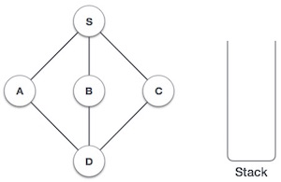
Graph Traversals
DFS (Depth First Search)
https://www.tutorialspoint.com/data_structures_algorithms/depth_first_traversal.htm

Slide 26
Tree Traversals
DFS (Depth First Search): example

Slide 27
Depth-First Search(DFS)
DFS
BFS
Branching factor 2, depth level 2
DFS opens nodes = 1+b*d = 5 BFS opens nodes = 1 + b + b² = 7
Branching factor 2, depth level 4
DFS opens nodes = 9 BFS opens nodes = 31
If branching factor is b and depth level is d, then DFS opens (1+bd) nodes
Notes:
Heuristic: enabling a person or entity to discover or learn something for themselves.

Slide 28
Depth-First Search(DFS)
For very large input size, If DFS made wrong choice then it is not complete neither optimal
DFS
S
G
Notes:
Heuristic: enabling a person or entity to discover or learn something for themselves.

Slide 29
Depth-First Search(DFS)
Depth First Search
Complete | No
Time Complexity | exponential
Space Complexity | bd
Optimality | No
Notes:
Heuristic: enabling a person or entity to discover or learn something for themselves.

Slide 30
Uniform Cost Search(UCS)
https://algorithmicthoughts.wordpress.com/2012/12/15/artificial-intelligence-uniform-cost-searchucs/
BFS finds the shallowest goal state, but it may not be the least-cost solution
UCS modifies the BFS by always expanding the lowest–cost node on the frontier (measured by Path-cost)
First solution found is gauranteed to be the cheapest solution
Uniform Cost Search use priority queue.
Uniform Cost Search gives the minimum cumulative cost the maximum priority
Notes:
Heuristic: enabling a person or entity to discover or learn something for themselves.

Slide 31
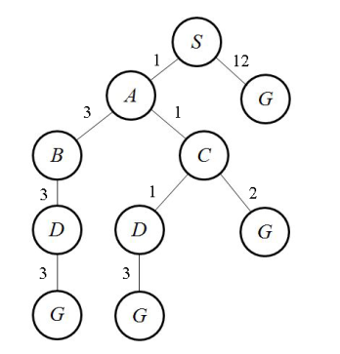
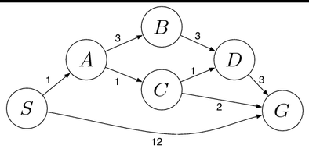
Uniform Cost Search(UCS)
Notes:
Heuristic: enabling a person or entity to discover or learn something for themselves.

Slide 32
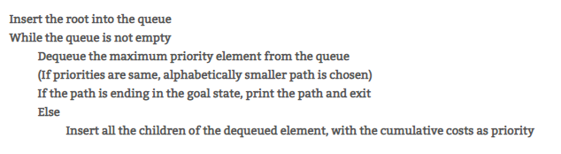
Uniform Cost Search(UCS)
Algorithm
The algorithm using this priority queue is the following:
Notes:
Heuristic: enabling a person or entity to discover or learn something for themselves.

Slide 33
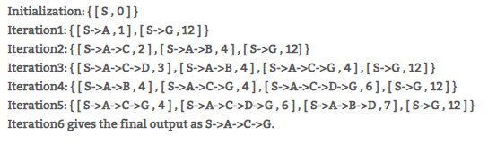
Uniform Cost Search(UCS)
Each element of the priority queue is written as
[path, cumulative cost].
Notes:
Heuristic: enabling a person or entity to discover or learn something for themselves.

Slide 34
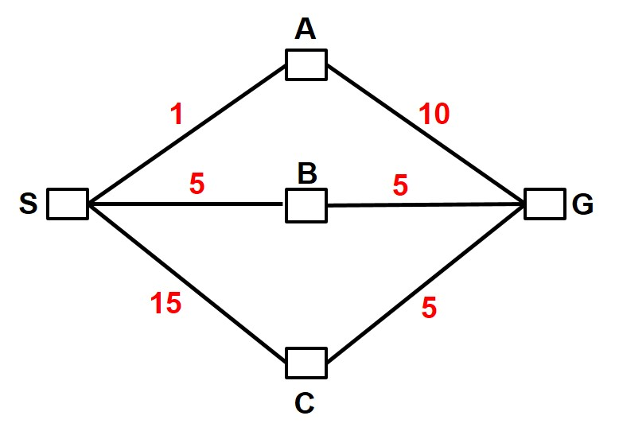
Uniform Cost Search(UCS)
Notes:
Heuristic: enabling a person or entity to discover or learn something for themselves.

Slide 35
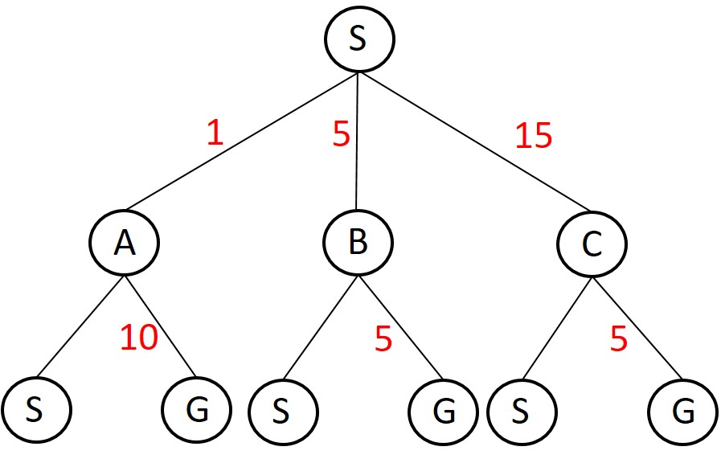
Uniform Cost Search(UCS)
Example:
Notes:
Heuristic: enabling a person or entity to discover or learn something for themselves.

Slide 36
A* Search
It improves the efficiency of the UCS algorithm with the help of heuristics.
A* Search also makes use of a priority queue just like Uniform Cost Search
For A*, we use the cost of getting to a node plus the heuristic at that point as the priority.
Let n be a particular node, then we define g(n) as the cost of getting to the node from the start state and h(n) as the heuristic at that node.
The priority thus is f(n) = g(n) + h(n). The priority is maximum when the f(n) value is least.
Notes:
Heuristic: enabling a person or entity to discover or learn something for themselves.

Slide 37
A* Search
Heuristic Function
A heuristic function, also called simply a heuristic, is a function that ranks alternatives in search algorithms at each branching step based on available information to decide which branch to follow.
Admissible Property
In computer science, specifically in algorithms related to pathfinding, a heuristic function is said to be admissible if it never overestimates the cost of reaching the goal, i.e. the cost it estimates to reach the goal is not higher than the lowest possible cost from the current point in the path
Notes:
Heuristic: enabling a person or entity to discover or learn something for themselves.

Slide 38
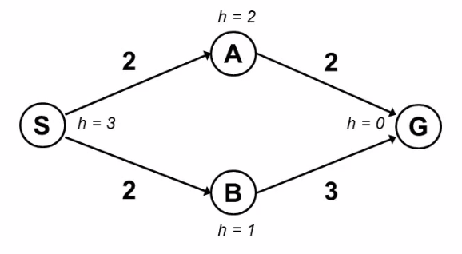
A* Search
Evaluation function f(n) = g(n) + h(n)
g(n) = cost so far to reach n
h(n) = estimated cost from n to goal
f(n) = estimated total cost of path through n to goal
Notes:
Heuristic: enabling a person or entity to discover or learn something for themselves.

Slide 39
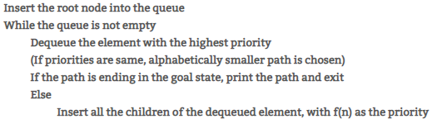
A* Search
Algorithm:
https://algorithmicthoughts.wordpress.com/2013/01/04/artificial-intelligence-a-search-algorithm/
Notes:
Heuristic: enabling a person or entity to discover or learn something for themselves.

Slide 40
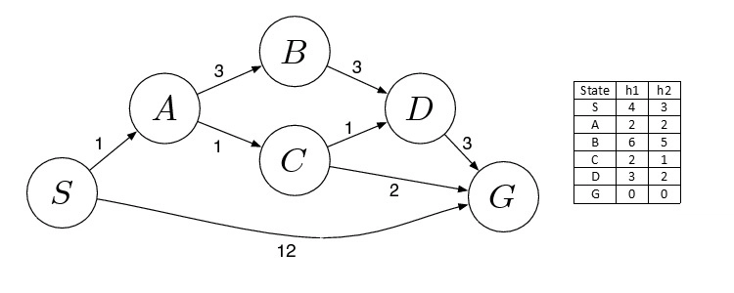
A* Search
Notes:
Heuristic: enabling a person or entity to discover or learn something for themselves.

Slide 41
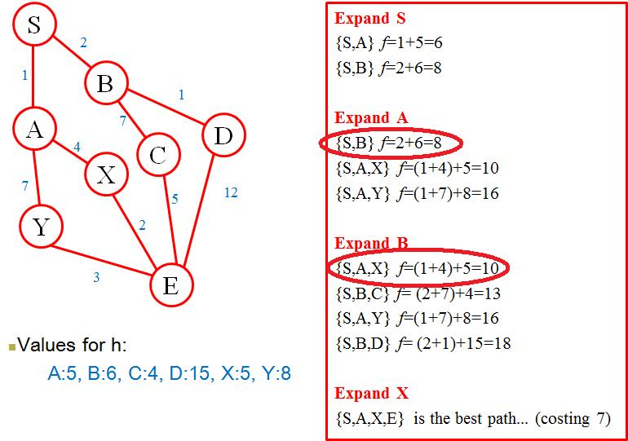
A* Search
Evaluation function f(n) = g(n) + h(n)
g(n) = cost so far to reach n
h(n) = estimated cost from n to goal
f(n) = estimated total cost of path through n to goal
Notes:
Heuristic: enabling a person or entity to discover or learn something for themselves.

Slide 42
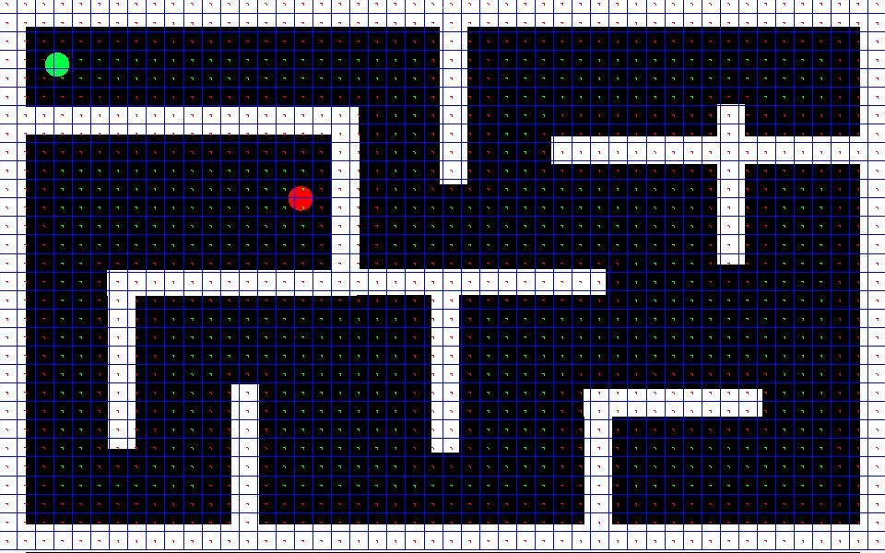
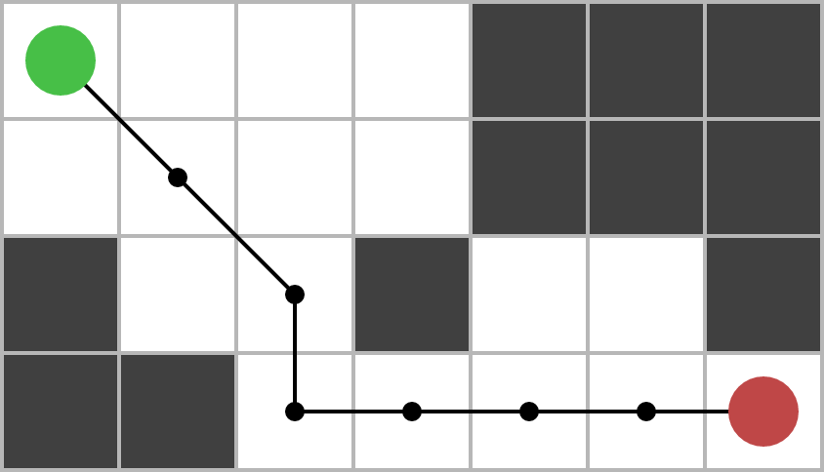
A* PathFinding
Notes:
Heuristic: enabling a person or entity to discover or learn something for themselves.

Slide 43

A* PathFinding
Notes:
Heuristic: enabling a person or entity to discover or learn something for themselves.

Slide 44
A* PathFinding
Example: https://www.raywenderlich.com/3016-introduction-to-a-pathfinding
Notes:
Heuristic: enabling a person or entity to discover or learn something for themselves.

